Slide 1
Introduction to intellectual property
Prepared by: Dr. MV Thuraisingham

Slide 2
The learning outcomes of these notes on intellectual property (IP) can be summarized as follows:
Understanding the Types and Purposes of Intellectual Property: Learners will comprehend the different forms of intellectual property, including patents, copyrights, trademarks, and trade secrets, and their respective roles in protecting creations of the mind.
Grasping the Core Principles of Intellectual Property: Learners will understand the foundational principles that govern IP protection, such as non-obviousness, novelty, utility, and originality, and why these principles are essential for the validity of IP rights.
Awareness of Global Intellectual Property Law: Learners will gain knowledge about how intellectual property laws vary across countries but are also harmonized through international treaties, and the role of organizations like WIPO in protecting IP worldwide.
Identifying Challenges and Controversies in Intellectual Property: Learners will be able to identify and discuss the major challenges in the enforcement of IP rights, including issues such as digital piracy, patent trolls, and the balance between IP protection and access to knowledge.
Recognizing the Economic Impact of Intellectual Property: Learners will appreciate how intellectual property contributes to economic growth, innovation, and cultural diversity by incentivizing creativity and investment, while also understanding the ongoing debate about the optimal extent and type of IP protection for societal welfare.
Application of Intellectual Property Knowledge: Learners will be equipped to apply their understanding of intellectual property in various contexts, such as creating, using, and managing IP assets, and will be aware of the importance of protecting these assets to promote innovation and fair competition in the market.

Slide 3
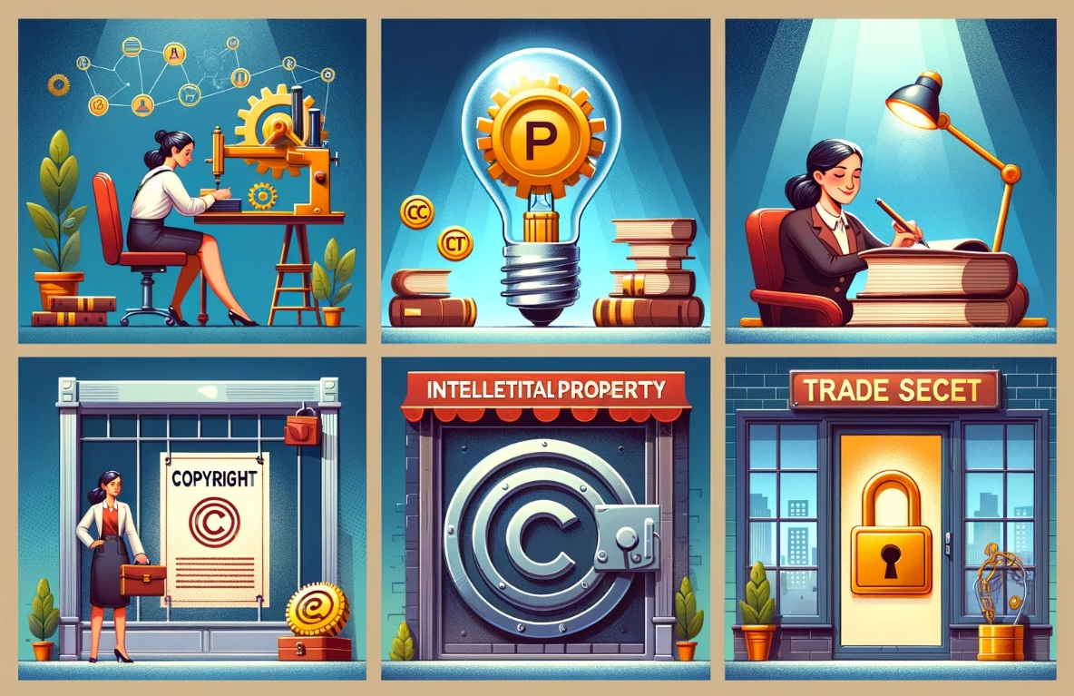
Intellectual property (IP)
Intellectual property (IP) refers to creations of the mind, such as inventions; literary and artistic works; designs; and symbols, names, and images used in commerce. IP is protected by law through patents, copyrights, trademarks, and trade secrets, enabling individuals or companies to earn recognition or financial benefit from what they invent or create. The protection of intellectual property encourages the investment of time, effort, and resources in innovation and creativity. Here are some key points and concepts in the realm of intellectual property:
The image above illustrates the key concepts of intellectual property (IP) through four scenarios:

Slide 4
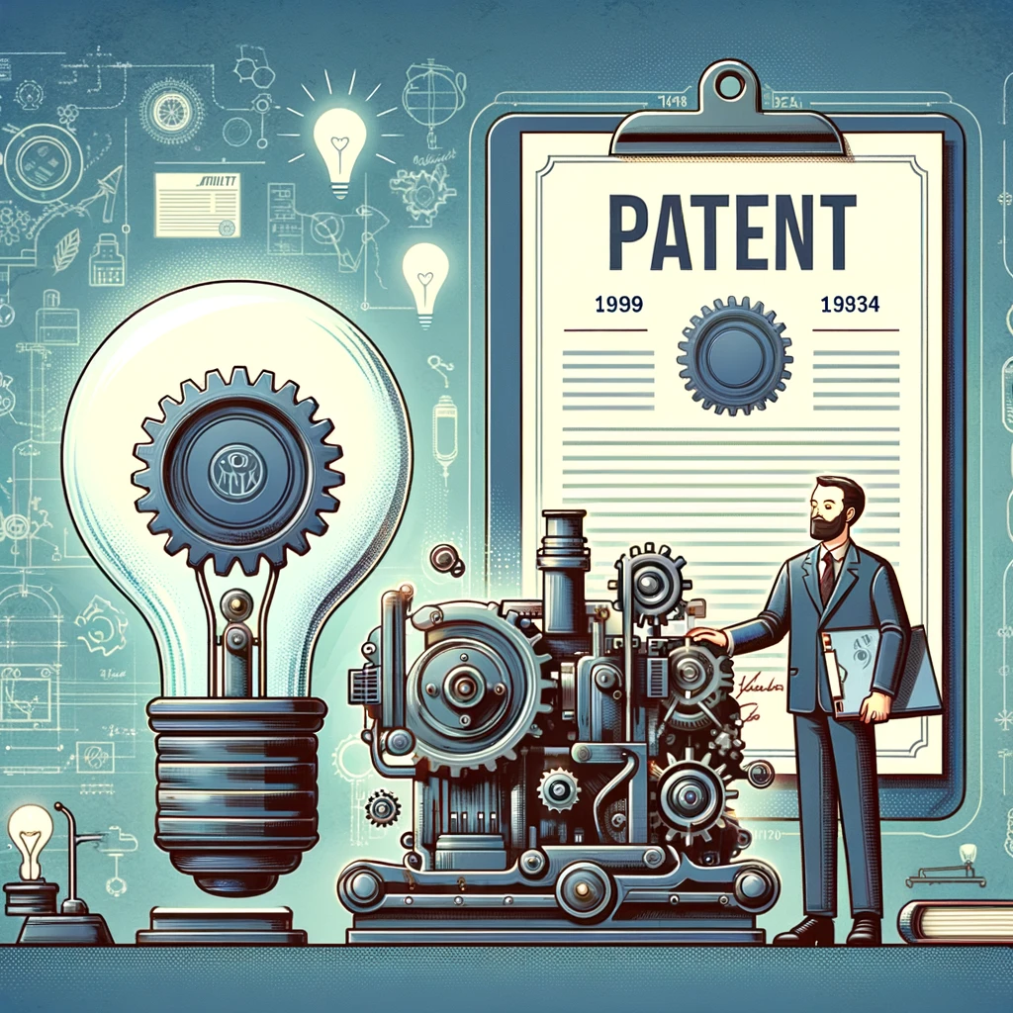
Types of Intellectual Property
Patents: Protect inventions and improvements to existing inventions for a period of time, typically 20 years. Patents grant the patent holder the exclusive right to make, use, or sell the invention.
Here's an illustration that visualizes the concept of patents. It showcases an inventor with their groundbreaking invention and a patent document, symbolizing the exclusive rights granted to the inventor to make, use, or sell the invention for a typical period of 20 years. This image captures the essence of patent protection and the encouragement it provides for innovation and creativity.

Slide 5
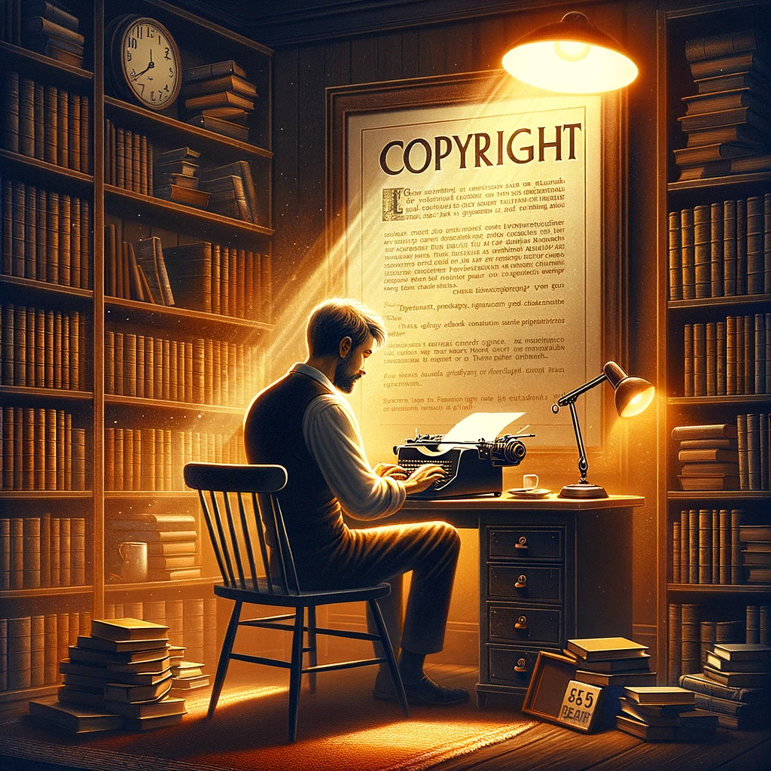
Types of Intellectual Property
Copyrights: Protect original works of authorship, including literary, musical, and artistic works, by giving the creator exclusive rights to use and distribute their work for a certain period, usually the author's life plus 70 years.
Here's an illustration that captures the concept of copyright protection. It portrays an author in the midst of the creative process, surrounded by the warmth and inspiration of their study, with a clear symbol of copyright protection displayed on the wall. This visual emphasizes the importance of copyrights in safeguarding original works of authorship, ensuring that creators have exclusive rights to their work for their lifetime plus seventy years.

Slide 6

Types of Intellectual Property
Trademarks: Protect symbols, names, and slogans used to identify goods or services. The protection can last indefinitely, as long as the trademark is in use and its registration is renewed.
The illustration provided visualizes the concept of trademark protection. It depicts a vibrant marketplace scene where various storefronts display unique logos or symbols, each marked with the trademark symbol to indicate their registered status. This scene highlights the role of trademarks in identifying and protecting the unique symbols, names, and slogans that represent goods and services, emphasizing that trademarks can last indefinitely with proper use and renewal.

Slide 7

Types of Intellectual Property
Trade Secrets: Protect confidential business information that provides a competitive edge. The protection lasts as long as the information remains a secret.

Slide 8

Types of Intellectual Property
The illustration provided offers a visual representation of the concept of trade secret protection. It features a high-tech laboratory setting where a scientist works on a confidential and potentially groundbreaking formula, emphasizing the critical nature of safeguarding sensitive business information. This scene captures the essence of how trade secrets, which provide a competitive edge, are protected and the importance of maintaining confidentiality to preserve a company's competitive advantage. The protection of trade secrets lasts as long as the information remains undisclosed, highlighted by the secure environment and the focus on confidentiality.

Slide 9
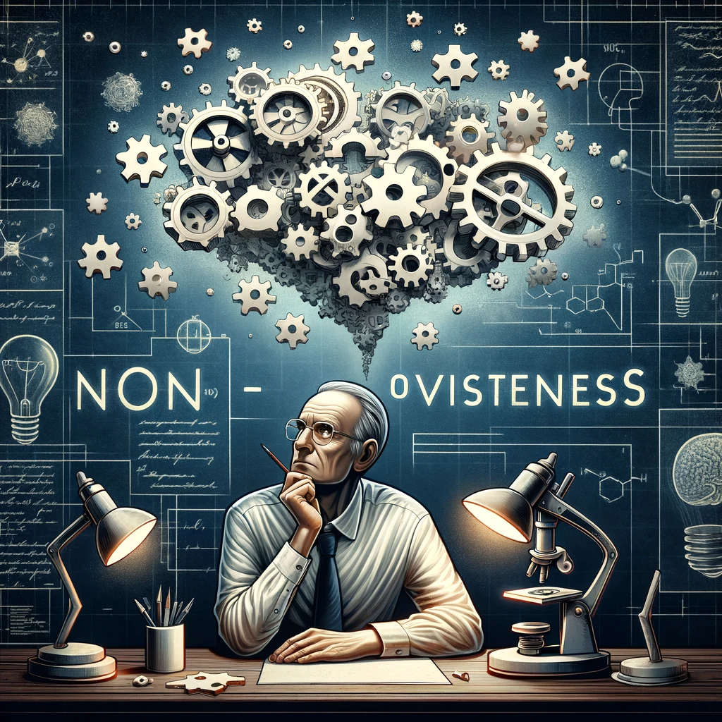
Principles of Intellectual Property
The principles of intellectual property include non-obviousness, novelty, utility, and originality, ensuring creations are new, not obvious, useful, and original for legal protection.

Slide 10
Principles of Intellectual Property
Non-obviousness: Particularly in patents, the invention must not be obvious to someone with knowledge and experience in the subject area.
The illustration provided captures the concept of non-obviousness, a crucial criterion in patent law. It features a scientist engaging deeply with a complex puzzle or mechanism that symbolizes an inventive process. The scene highlights the intellectual challenge of creating something not immediately apparent to others with expertise in the field, emphasizing the requirement for an invention to be non-obvious to those well-versed in the subject area for it to be patentable. This visualization underscores the significance of non-obviousness in fostering innovation and securing patent protection.

Slide 11

Principles of Intellectual Property
Novelty: The creation must be new and not previously disclosed or patented.
The illustration provided embodies the concept of novelty in the context of intellectual property. It features a glowing light bulb over a blank canvas, representing a fresh, unprecedented idea amidst a backdrop of discarded and previously explored concepts. This visual metaphor highlights the essence of novelty — for an invention or creation to be protected under IP laws, it must be completely new and not previously disclosed or patented. This scene conveys the excitement and innovation inherent in creating something truly original and unique.

Slide 12

Principles of Intellectual Property
Utility: For patents, the invention must be useful.
The illustration vividly captures the concept of utility in patent law, showcasing a futuristic device designed to purify water. Set against the backdrop of a parched desert landscape, the device illustrates its invaluable purpose by transforming impure water into clean, drinkable water, highlighting the immediate usefulness and broader societal benefits of such inventions. This visualization underscores the essential criterion for patentability: an invention must have clear utility or functionality that benefits its users.

Slide 13
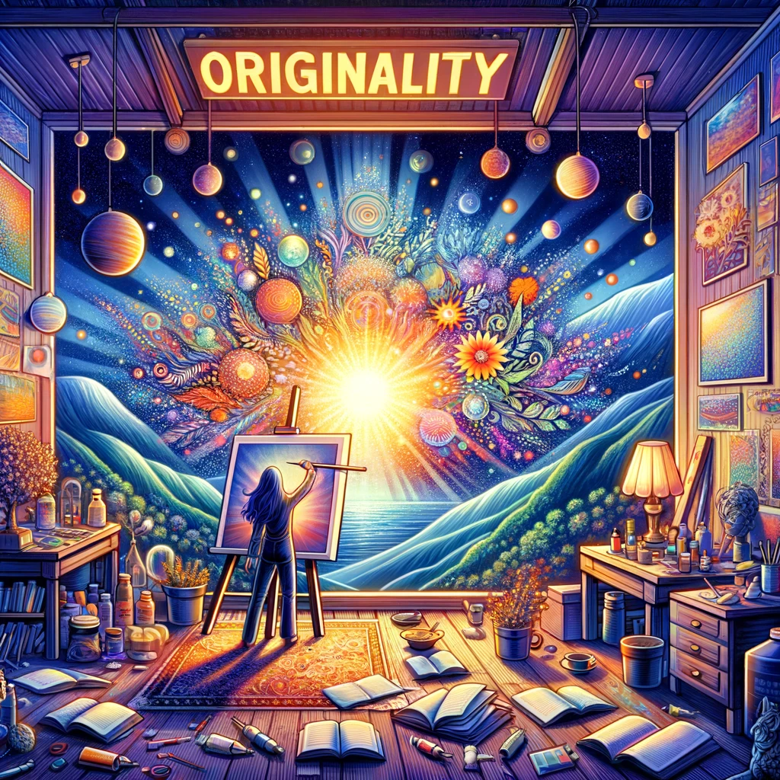
Principles of Intellectual Property
Originality: For copyrights, the work must originate with the author and exhibit some degree of creativity.
The illustration provided brings to life the concept of originality in copyright law, depicting an artist immersed in creating a truly unique and vibrant painting. The scene captures the essence of originality, with the artwork standing out as a testament to the author's personal creativity and distinct vision, separate from the various sources of inspiration surrounding them. This visual emphasizes that for a work to be eligible for copyright protection, it must be an original creation that originates from the author and showcases a degree of creativity, distinguishing it from mere adaptations or copies of existing works.

Slide 14

Global Intellectual Property Law
Global Intellectual Property Law refers to the international rules and agreements that harmonize the protection of intellectual property across different countries.

Slide 15
Global Intellectual Property Law
Intellectual property laws vary by country, but many aspects are harmonized through international treaties, such as the Paris Convention, the Berne Convention, and the Agreement on Trade-Related Aspects of Intellectual Property Rights (TRIPS).
The illustration captures the global nature of intellectual property laws and their harmonization through key international treaties. Featuring a globe surrounded by iconic landmarks, each symbolizing different aspects of intellectual property rights, and floating documents representing the Paris Convention, the Berne Convention, and the TRIPS Agreement, it visually conveys the idea of worldwide efforts to align intellectual property laws. This scene highlights the concerted effort to promote a global understanding and enforcement of intellectual property rights, despite the variations in laws from country to country.

Slide 16

Global Intellectual Property Law
Organizations like the World Intellectual Property Organization (WIPO) work to protect intellectual property across nations.
The illustration provided visualizes the role of the World Intellectual Property Organization (WIPO) in safeguarding intellectual property rights globally. It features the WIPO headquarters with a diverse group of individuals from various parts of the world congregated around it, each person holding a symbol of different types of intellectual property. Above them, a banner proclaims "WIPO - Protecting IP Worldwide," encapsulating WIPO's mission of promoting international cooperation and ensuring the protection of IP rights across diverse countries and cultures. The inclusion of a world map in the background further emphasizes the extensive reach and impact of WIPO's efforts around the globe.

Slide 17

Challenges and Controversies
Enforcement: Protecting IP rights across different jurisdictions can be challenging.
The illustration provided delves into the complexities of enforcing intellectual property rights across various jurisdictions. It features a detailed depiction of the globe, adorned with iconic landmarks from around the world, interconnected by a network of legal documents and gavels. This network represents the intricate legal processes involved in IP protection.

Slide 18
Challenges and Controversies
Surrounding the globe, individuals in roles crucial to the IP enforcement process—such as lawyers, judges, inventors, and business owners—are seen engaging in discussions, negotiations, and document examinations. This scene underscores the global priority of IP protection and the collaborative, nuanced understanding of different legal systems required to navigate the enforcement landscape effectively. The illustration highlights the challenges and concerted efforts needed to safeguard IP rights across the globe.

Slide 19

Challenges and Controversies
Digital Piracy: The internet has made it easier to infringe on copyrights, especially for music, films, and software.
The illustration provided delves into the issue of digital piracy, focusing on its impact on music, films, and software. It features a computer screen displaying a piracy website with symbols of illegally downloaded movies, music, and software applications. Shadowy figures around the computer represent users engaging in piracy, while broken chains or locks in the background symbolize the breach of copyright protections. This scene effectively conveys the challenges copyright holders face due to the ease of pirating digital content over the internet, highlighting the negative consequences of digital piracy on creators and industries in an ominous setting.

Slide 20

Challenges and Controversies
Patent Trolls: Entities that buy patents not to produce goods but to sue companies for patent infringement.
The illustration vividly captures the metaphorical concept of patent trolls, depicting a large, ominous troll figure perched atop a pile of patent documents. With a magnifying glass in one hand for scrutinizing patents and a gavel in the other, symbolizing readiness for legal action, the troll looms over small figures representing various companies. These companies appear concerned and defensive, some even holding shields or barriers to protect themselves. This scene effectively conveys the predatory nature of patent trolls, who acquire patents not to innovate or produce goods but to sue companies for alleged patent infringements, highlighting the intimidation and disproportionate power dynamics involved.

Slide 21

Challenges and Controversies
Access vs. Protection: Balancing IP protection with the need for access to knowledge, especially in areas like medicine and education.
The illustration provided beautifully captures the intricate balance between protecting intellectual property and ensuring access to knowledge, with a particular focus on medicine and education. It features a scale in perfect equilibrium, where one side holds a locked treasure chest symbolizing IP protection, and the other side carries an open book and a medical cross, representing the crucial need for access to knowledge and healthcare.

Slide 22
Challenges and Controversies
Surrounding the scale, figures from diverse backgrounds, including scientists, educators, students, and medical professionals, are depicted engaging in collaborative discussions, highlighting the communal effort to share ideas and resources. This scene underscores the ongoing challenge of ensuring that IP laws safeguard creators and innovators while also facilitating the widespread dissemination of knowledge and advancements, all within an atmosphere of harmony and mutual respect.

Slide 23
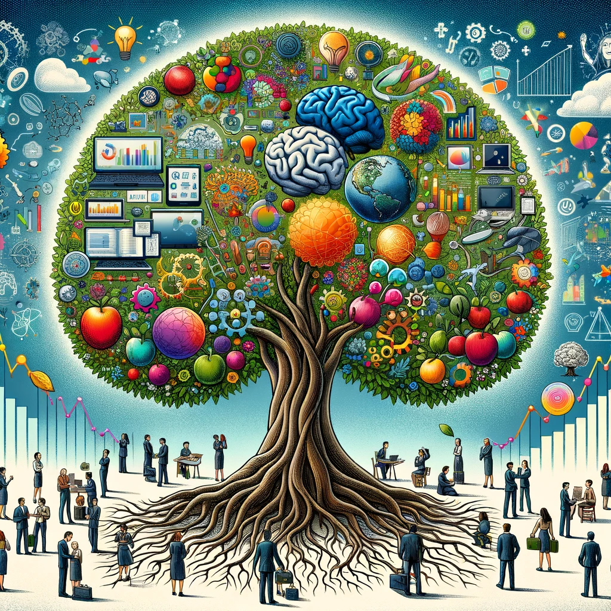
Economic Impact
Intellectual property drives economic growth, innovation, and cultural diversity by incentivizing creativity and investment.
The illustration vividly represents how intellectual property (IP) acts as a catalyst for economic growth, innovation, and cultural diversity. It features a vibrant tree with roots shaped like a brain, symbolizing the deep-rooted connection between IP and human creativity. The tree's branches extend into various sectors—technology, arts, and science—each adorned with fruits representing inventions, artworks, and innovations.

Slide 24
Economic Impact
However, there is debate over the extent and type of IP protection that is optimal for societal welfare.
Surrounding the tree, people from diverse cultural backgrounds contribute their ideas, illustrating the global influence of IP in encouraging creativity and investment. Symbols of economic prosperity float above the tree, signifying the beneficial impact of IP on economic development. This scene encapsulates the cycle of creation, protection, and benefit, highlighting IP's role in fostering a diverse and innovative global culture.

Slide 25
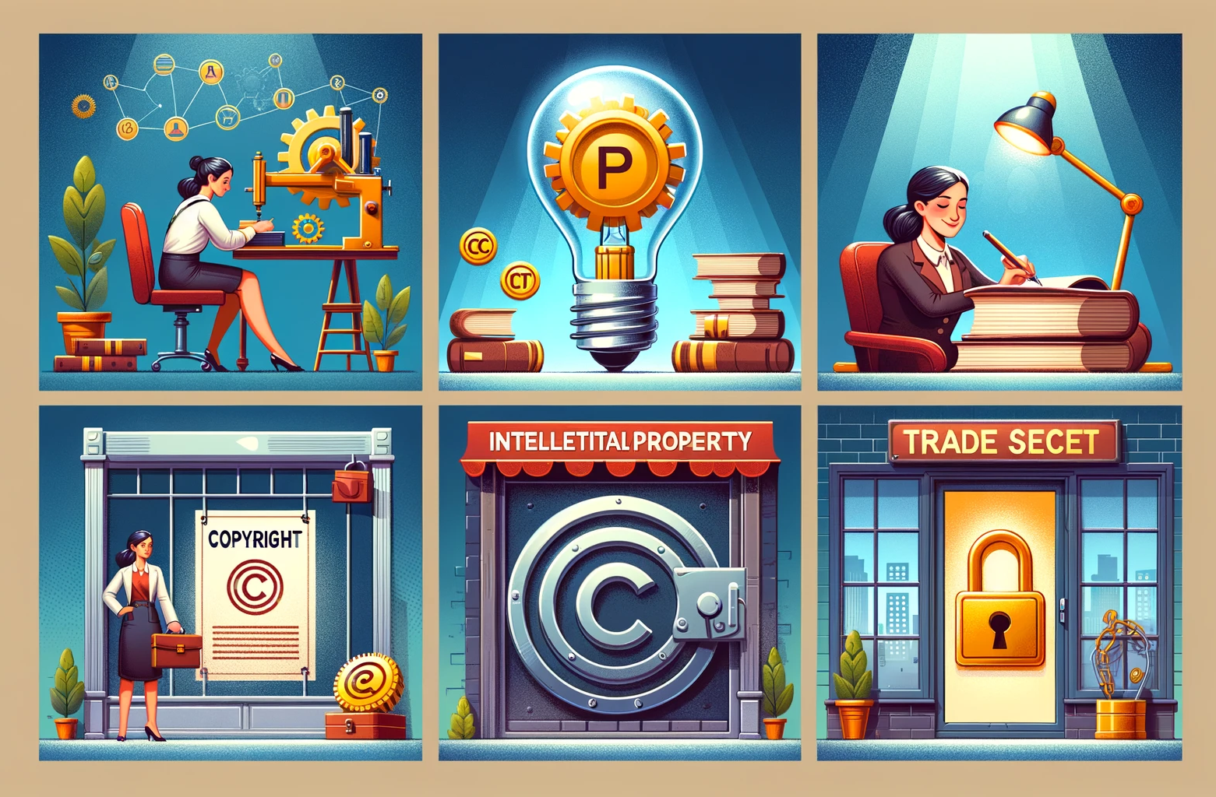
Understanding intellectual
Understanding intellectual property is crucial for anyone involved in creating, using, or managing intellectual assets, whether they're inventors, authors, entrepreneurs, or legal professionals. The goal is to protect these assets while promoting innovation and fair competition in the market.

